Slide 1
UNIT IV
Professional Communication for Employment
Listening Comprehension
Types of Listening & Barriers
Improving Listening skills
Reading Comprehension
Tips for effective Reading
Job Application
Drafting effective Resume/Curriculum Vitae (CV)
Writing formal Email

Slide 2
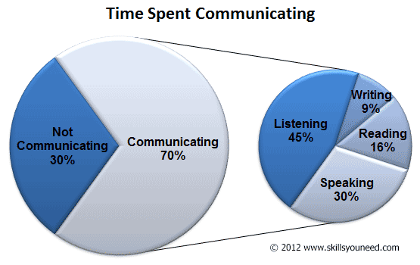
INTRODUCTION TO LISTENING

Slide 3
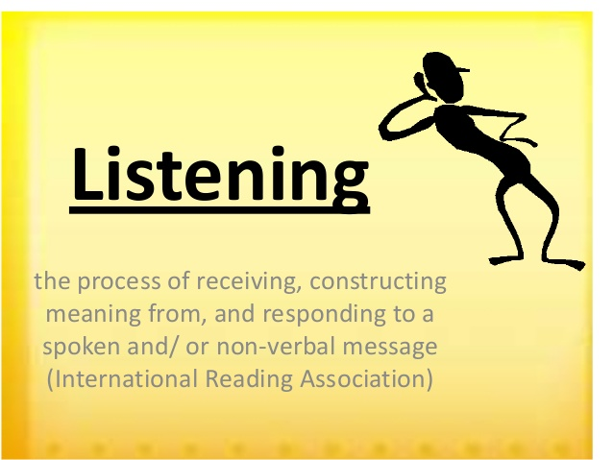

Slide 4
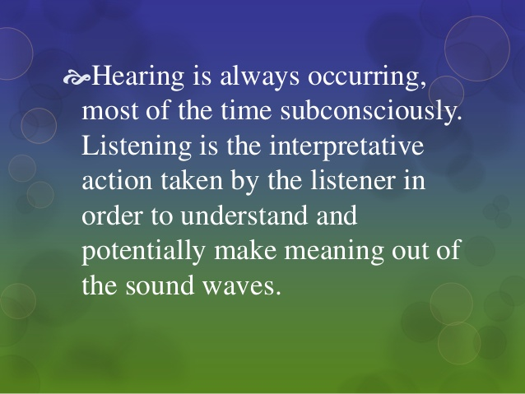

Slide 5
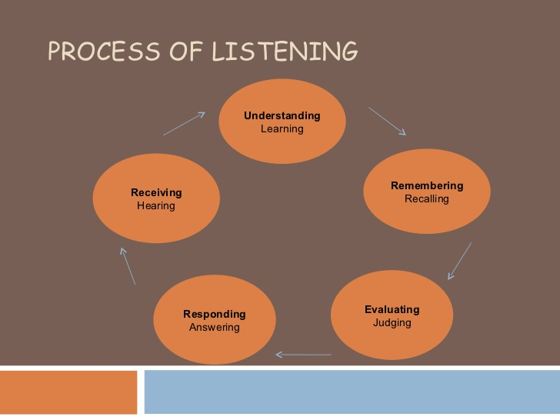

Slide 6
Answer the following questions by choosing correct options giving below.
1. Which is true?
Listening and hearing are remarkably similar.
It is possible to hear without listening.
Listening is physical; hearing is psychological.
It is possible to listen without hearing.
2. Which is true?
a) Listening is a natural process. b) Listening requires effort.
c) All listeners receive the same message. d) All of these are true.
3. Listening is poor when
a)We don't expend the effort. b) We experience message overload.
c) We experience psychological noise. d) All of these are correct.
4. Which of these is not a step in the listening process?
a) Remembering b) Receiving
c) Misinterpreting d) Responding
5. Which of these is the first step in the listening process?
a) Stop talking b) Receiving
c) Interpreting d) Responding

Slide 7
6. is the last step of the listening process.
a) Receiving b) Interpreting
c) Responding d) Stop talking
7. Which of these is not a type of listening?
a) Appreciative listening b) Deep listening
c) Critical listening d) Comprehensive listening
8. Which of these types of listening is followed by skilled listeners?
a) Focused listening b) Critical or Evaluative listening
c) Attentive listening d) Empathetic listening
9. In which of these, the listener puts himself in place of the speaker?
a) Focused listening b) Evaluative listening
c) Attentive listening d) Empathetic listening
10. Generally people speak between 100 and 140 words a minute, but we are capable of understanding speech at words per minute.
a) 600 b)200 c)750 d) 1,500

Slide 8
Answer
1.B. It is possible to hear without listening.
2.B. Listening requires effort.
3.D. All of these are correct.
4.C. Misinterpreting
5.A. Stop talking
6.C. Responding
7.C. Critical listening
8.B. Critical or Evaluative listening
9.D. Empathetic listening
10.A. 600 words

Slide 9
Types of Listening
Active Listening
Passive Listening
1.Discriminative Listening
2. Comprehensive Listening
3.Therapeutic Listening
4. Critical Listening
5. Appreciative Listening.
6.Empathetic Listening.

Slide 10
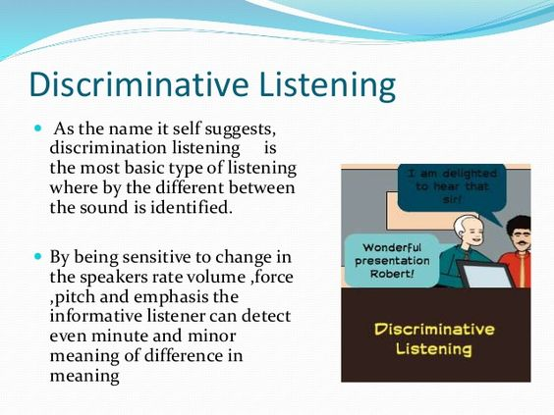

Slide 11
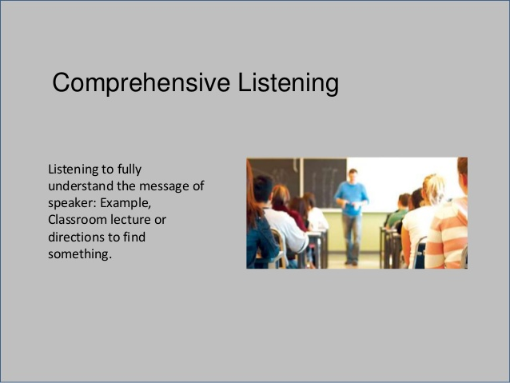

Slide 12
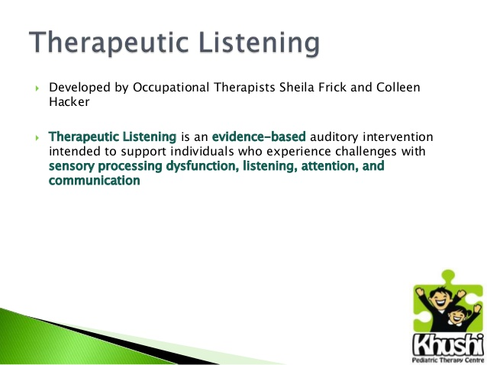
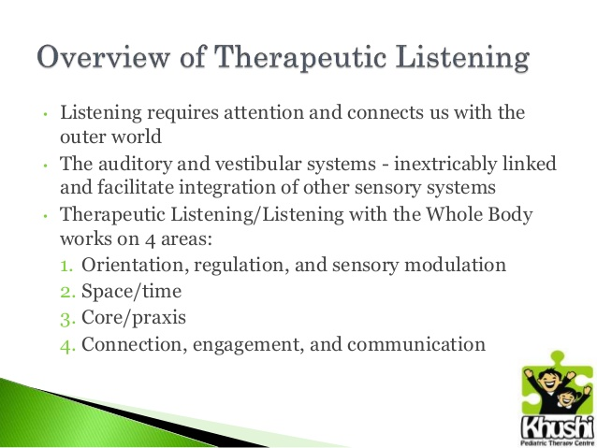
Notes:
Vestibular refers to the balance system of the inner ear. Praxis-theory

Slide 13
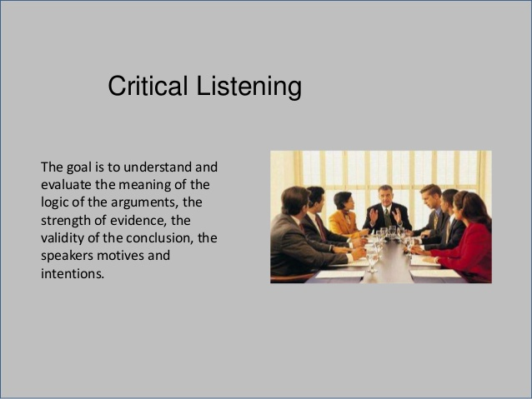

Slide 14
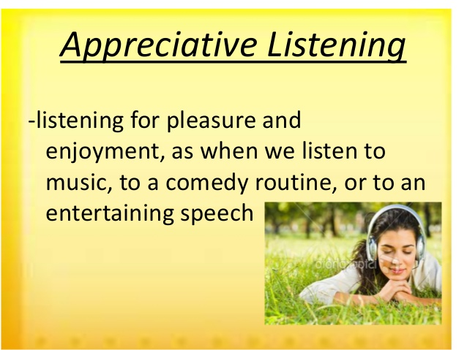

Slide 15
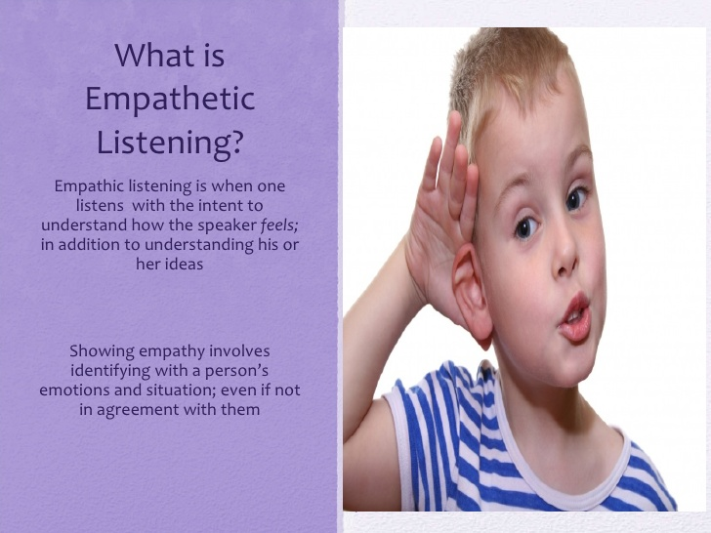

Slide 16
Difference between Active and Passive listening.
Active listening | Passive listening
Is a cognitive purpose. | No cognitive purpose.
Need to comprehension. | Need not necessarily comprehend.
Paraphrasing is required. | No paraphrasing is required.
Questions can be asked. | No questions can be asked.
Exhibit non-verbal responses. | No non-verbal signals.

Slide 17
Difference between Active and Passive listeners.
ACTIVE LISTENERS: The listener participates fully in the communication process. Listener listens attentively, provide feedback, and strive to understand and remember messages.
They focus on the content as well the manner in which it is delivered. This means that they will take note of the verbal content along with its nonverbal subtexts.
They will not hesitate to seek clarifications, ask leading questions, show their approval by nodding head, and summarize to clearly indicate that they fully follow the speaker.
The active listeners are quiet sensitive towards the feelings of others; they understand the mood of the audience.
They show empathy and make the audience or the other person cared for. Once the audience gets the feeling that they are being cared for, they will devote themselves fully to the communication process.

Slide 18
PASSIVE LISTENERS: The listener does not actively participate in interactions. They think they can absorb information even when they do not contribute to the interaction. They place the responsibility for successful communication on the speaker.
Passive listeners exhibit exactly the opposite behavioristic traits of active listeners.
They pay attention only to partial message and lack of sensitivity to the nuances, inner meanings, nonverbal subtexts involved in communication.
They allow someone to speak, without interrupting or seeking clarifications.
They do not make notes, nod their head in approval, maintain eye contact and keep themselves idle.
Passive listeners who accept not evaluate.
Passive listener who suspends judgment and just listens.

Slide 19
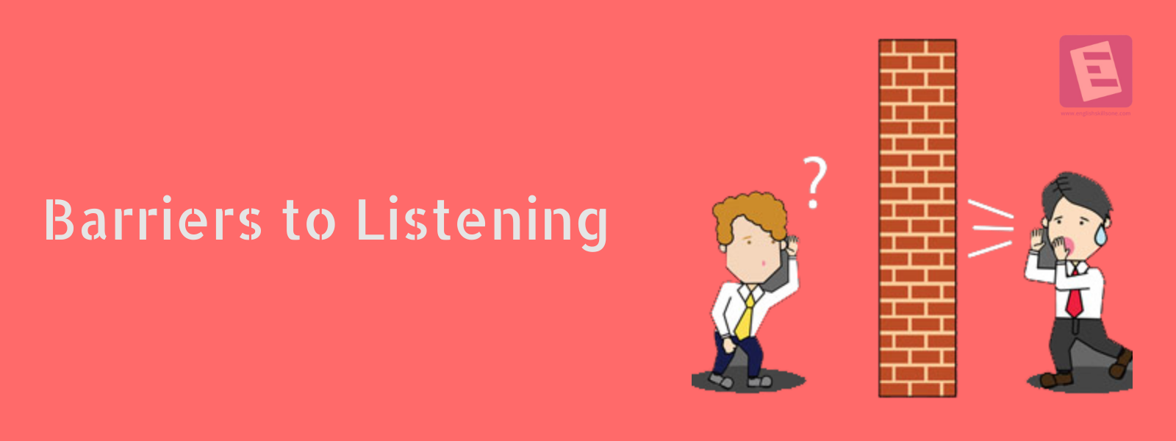
BARRIERS TO LISTENING
1.Excessive Talking
2.Prejudice
3.Distractions
4.Misunderstanding
5.Interrupting
6.Fake Attention
7.Bringing in Emotions
8.Noise
9.Fear
10. Expecting others to share your personal
Beliefs and Values

Slide 20
Answer the following questions by choosing correct options giving below.
1. Which of these should be avoided for effective listening?
a) Pre-listening analysis b) Listening to structured talks
c) Team listening d) Predicting
2. In which of these does the listener pick up special features of the speech?
a) Listening in conversational interaction b) Listening to structured talks
c) Predicting d) Team listening
3. A well organized talk is a talk.
a) Short b) long
c) Random d) structured
4 Which of these should be avoided in pre-listening analysis?
a) Mental discipline b) Concentration
c) Prejudices d) Patience
5. Predicting’ is the technique to forecast what the speaker will say.
a) True b) False

Slide 21
6. In which of these, should the listener be able to make connections between different segments of the speech?
a) Listening to structured talks b) Links between parts of the speech
c) Team listening d) Predicting
7. Which of these is based of effective listening?
a) Note taking b) Notice writing
c) Letter writing d) Predicting
8.Which of these should be avoided while note taking?
a) Concentration b) Evaluation
c) Listening d) Using phrases
9. Which of these is not a type of text for reading?
a) Reference material b) Chats
c) Scientific text d) Technical text
10. Which of these is not a deterrent to the listening process?
a) Lack of interest c) Confidence
b) Ego d) Fear

Slide 22
Answer
1.D. Predicting
2.A. Listening in conversational interaction
3.D. structured
4.C. Prejudices
5.A. True
6.B. Links between parts of the speech
7.A. Note taking
8.B. Evaluation
9.B. Chats
10.C. Confidence

Slide 23
Improvising Listening Skills
Hearing or Receiving
Understanding (Comprehension)
Remembering
Evaluating
Feedback
Slow our listening down
Pay attention

Slide 24
Answer the following questions by choosing correct options giving below.
1. Which of these is not a barrier to listening?
a) Physical barrier b) Cultural barrier
c) Linguistic barrier d) Written barrier
2. Which is the main barrier to listening?
a) Physical barrier b) Linguistic barrier
c) Cultural barrier d) Physiological barrier
3. Which of these is not a physiological barrier?
a) Fear b) Different perception
c) Gel effect d) Halo effect
4. Which of these is based on faith?
a) Fear b) Halo effect
c) Emotions d) Different perception
5. When people take extreme positions what is it called?
a) Fear b) Halo effect
c) Emotions d) Polarization

Slide 25
6. Which of these occur because of difference in language?
a) Physical barriers b) Linguistic barriers
c) Cultural barriers d) Speech decoding
7.Barriers which are caused because of different meanings of a word to different people is called
a) Different perception b) semantic distortions
c) Physical barriers d) cultural barriers
8. Which of these barriers occur when people belong to different religious backgrounds?
a) Physical barriers b) Linguistic barriers
c) Cultural barriers d) Speech decoding
9. Who among these bow down to greet?
a) Japanese b) Americans
c) Indians d) French
10. Which of these is not a step in speech decoding?
a) Listening b) Writing
c) Translating d) Understanding

Slide 26
Answer
1.D. Written barrier
2.A. Physical barrier
3.C. Gel effect
4.B. Halo effect
5.D. Polarization
6.B. Linguistic barriers
7.B. semantic distortions
8.C. Cultural barriers
9.A. Japanese
10.B. Writing

Slide 27
READING SKILLS

Slide 28
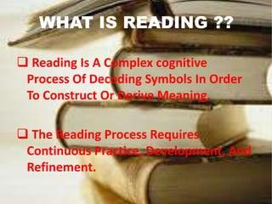
Reading Comprehension

Slide 29
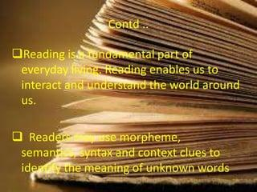

Slide 30
READING TECHNIQUES
Skimming: Skimming of a lesson, means gathering together salient facts contained in it. Skimming of a prose, paragraph means going through it and collecting main points contained therein. Surely the reader is able to take out the best contained there in the lesson or the paragraph.
Skimming is used to get the gist of a content in a textbook to decide whether it is useful and should therefore be read slowly and more detail.
Purpose: The practice of skimming is very important for senior students. It gives them a lot of confidence. The main purpose of the person is to assemble the main things or ideas contained therein. EX: Reading notes, Newspaper, Magazine.
Process of Skimming:
Reading or glancing through quickly.
Helps in the rapid reading of short, simple, light reading materials.
To get a rough idea of what the book is about.
Involves: Pre-reading, Reading, Reviewing.
Imagine your eyes as magnets; move them fast to pick only the keywords/main points (usually at the first; middle, last sentence).

Slide 31
2. Scanning: is used to obtain a specific information from a piece of text for example, to find t a particular number in a telephone directory.
Meaning: Scanning of a book or a paragraph means collecting detained information contained in the subject matter.
Example: Checking a number in a dictionary; training timing, historical events; birth date, etc.
Purpose: Scanning of materials is recommended for the senior students. It teaches them to call a spade. It also develops the habit of working hard. It helps them in developing a scientific attitude in teaching and understanding things which is very important in life. They tend to read the subject matter continuously and carefully.
Process of Scanning:
Reading a text quickly to find exact information. E.g. figures or names. Use ‘WH’ questions.
Locate key facts.
Look for specific bits of information.
The reader goes through the subject matter with searching books.
He/she examines everything very closely.
So much that the reader is not allowed to ignore. Even a single difficult word contained therein. In scanning everything good or bad is pointed out.
Everything objectively and in a very scientific manner is highlighted.

Slide 32
TYPES OF READING
Intensive and extensive reading:
Intensive reading: If the purpose is to read a text in great detail or carefully intensive reading is required. Generally, textbooks called readers concentrate on intensive or detailed reading. Comprehensions, exercises on vocabulary, grammar, speaking and punctuation are set to make the student read the text carefully.
Ex: Reading notes for test preparation.
Extensive reading: On free reading for pleasure for interest in the subject matter or for the acquisition of information. It provides an encounter with language which is essential for the mastery of the language.
Ex: Reading novel for pleasure.

Slide 33
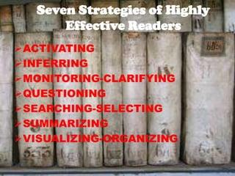
Tips for Effective Reading

Slide 34
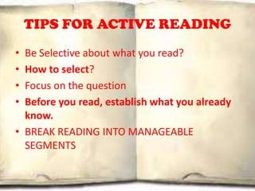

Slide 35
Passage:
Some years ago I had the privilege of meeting the world’s oldest man. At least he said he was. And he was. And he was so dogmatic about it that the promoters of a cartoon strip that specialized in unbelievable oddities brought the old man up to New York from his native Columbia, to have him examined by a team of doctors at the Cornell Medical Centre. He was an Indian, he was four feet four inches high, he had an alligator-hide complexion and a tendency to swing with his right whenever he passed from one medico to another. He said he was 167, born the same years as the American constitution. When the name of George Washington was suggested to him, to help him fix his generation, he said he remembered the man well. But he resented coming all the way to New York. He wanted to be left alone to go about the business, which at that time was the business of looking for a sixth wife to comfort him in his approaching old age!

Slide 36
Read the passage and answer the following questions that follow.
1. The old man was ‘dogmatic’ about the fact that
he was four feet four inches tall.
he was the world’s oldest living man.
he belonged to Columbia.
he had an alligator-hide complexion.
2. The cartoon strip people got interested in him because
he was comical creature
they wanted to feature him in a cartoon strip.
a person surviving at that age was odd and unbelievable.
he had the tendency of swinging with his right.
3. The old man claimed that the Americans gave themselves a Constitution
before he was born
in the year of George Washington’s birth
two centuries ago
One hundred and sixty seven years ago.
4. George Washington’s name was mentioned to the old man
to teach him a bit of history.
To know whether he had personal equation with Washington.
to make fun of his advanced age.
to determine his age.
5. The old man did not like being brought to New York because
At that time he was busy looking for a sixth wife.
he didn’t like travelling much.
he didn’t like New York as a city.
he preferred to be left alone in his native village.

Slide 37
Answers- Passage:
B. He was the world’s oldest living man.
C.A person surviving at that age was odd and unbelievable.
D. One hundred and sixty seven years ago.
D. To determine his age.
A. At that time he was busy looking for a sixth wife.

Slide 38
Job Application Drafting effective Resume/Curriculum Vitae (CV) Writing formal Email

Slide 39
A letter is a written message that can be handwritten or printed on paper. It is usually sent to the recipient via mail or post in an envelope, although this is not a requirement as such. Any such message that is transferred via post is a letter, a written conversation between two parties.
Types of Letters
Formal Letter
Informal Letter
Business Letter
Official Letter
Social Letter
Circular Letter
Employment Letters

Slide 40
Drafting job Application (Cover letter) and Resume
Rakesh Sharma 20th January 2023 MSR Nagar Bangalore. Rsharma@hotmail.com MrsMattyJenkyns HR Manager Manyatha Tech Park Bangalore. Respected Sir/Madam, Subject: Application for the post of Software Engineer. | Tries to find the name of the appropriate person to write to if possible.
I am looking for a placement within a software industry. I am writing to you as I understand that IBM may have appropriate vacancies available. I have a strong interest in software programming which I understand are predominantly carried out at this company. As I live only 5 miles from your site, travel and accommodation would not be a problem for me. | States the job she's applying for. States when he/she's available to start and end the placement.
I first became interested in the software programming from my college days learning. Since then, discussion with my careers adviser has confirmed my decision to aim for a career in this field. | Says why she's interested in the type of work.
Through my degree course, I achieved 68% in my final year examinations. During my college studies, I have also been able to utilize my skills in working with people through a variety of vacation jobs. | Summarizes her strengths and how they might be an advantage to the organization. Relates her skills to the job.
I would be most grateful if you could consider me for any suitable positions. I will be available for interview at any time and am at my home address in Bangalore from late December onwards. Please find enclosed my CV where you will find further information. Yours sincerely Rakesh Sharma (Signature) Enclosures: 1.Resume 2.Marks cards | Mentions dates she would be available for interview. Thanks the employer and mentions an enclosed CV.

Slide 41


Slide 42
The major difference between Bio-data, curriculum vitae (CV), and Resume:
Bio-data is short form of biographical data. It implies a shortened version of the autobiography.
It follows a chronological order, it starts with the first thing that is, name, father’s name, date of birth, and so on.
Past information is collected to predict future performance.
The bio-data includes physical attributes such as age, height, weight, even in some cases, the colour of hair, skin, and eye.
It is combined with the latest passport size photograph of the candidate. The usage of Bio-data functionally originates from the British and is practiced commonly in India.

Slide 43
Curriculum vitae: CV is short form of curriculum vitae, a Latin phrase, which means “the course of life.”
It is taken to mean one’s career graph or career progress.
The focus here is more on the career.
It is an overview of a person’s experience and other qualifications.
It is a long synoptic account of the candidate’s professional experience, qualifications, and some personal information.
Although some personal information is added, the larger perspective is on career progress.
The emphasis of the information changes according to the particular position applied.
Résumé: Resume is typically American, in which, personal, family, social, and religious backgrounds are ignored.
Résumé, meaning summary in French, is a short descriptive account of one’s academic and work history.
The life details are very minimal, almost nothing in this.
Résumé is a document containing a focused sketch of relevant job experience and education.

Slide 44
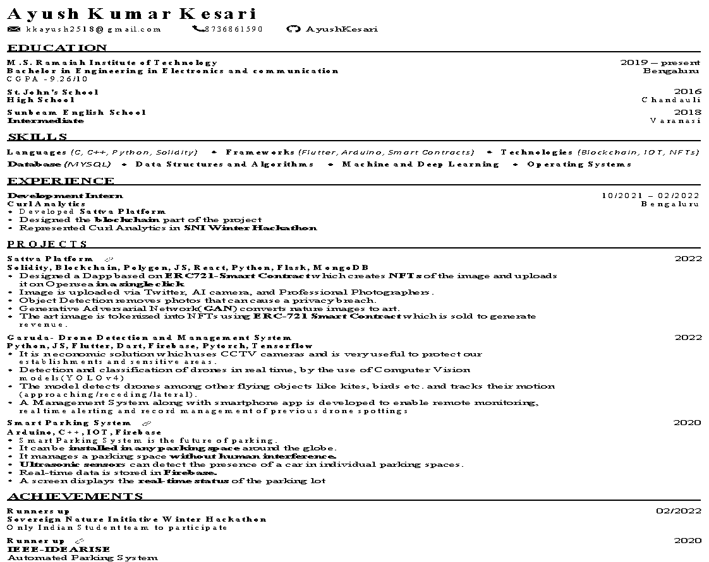

Slide 45
Impressive Resume format
Attractive Paper
Well Printed Paper
Consistency
Perfect spacing
Length
Format
Avoid irrelevent points

Slide 46
WRITING FORMAL EMAIL

Slide 47
INTRODUCTION
Meaning: Email stands for electronic mail. It is the easiest and the cheapest way of communication. It is used in formal, semi-formal as well as an informal way of expressions or writing.
Email communication offers more advantages; it’s inexpensive and saves papers and promotes green initiatives. It is convenient and saves time.

Slide 48
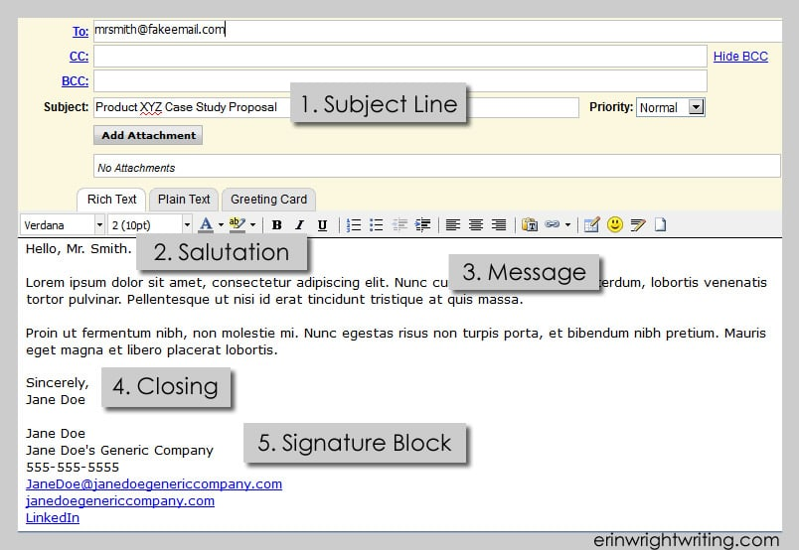
EMAIL FORMAT

Slide 49
Write an email for Inviting to your parents for college fest which will be held on January 21st 2023.
To: dennispeter@gmail.com
Cc:
Bcc:
Subject: Invitation.
Dear Parents,
Hope you all are well.
I am very glad to invite you for the Annual college fest-2023 which is going to be held on January 21st 2023 in our college. It’s been really long since caught up, so I think its great occasion to have lots of fun and love.
The annual college fest will be so grand and it showcases our talent as well, please be with us and encourage.
Hope to hear from you soon.
Best regards
XYZ

